Slide 1
BARACK & MICHELLE OBAMA ACADEMY
BUDGET FEEDBACK MEETING
February 15, 2023

Slide 2




NORMS
This is a meeting of the GO Team. Only members of the team may participate in the discussion. Any members of the public present are here to quietly observe.
We will follow the agenda as noticed to the public and stay on task.
We invite and welcome contributions of every member and listen to each other.
We will respect all ideas and assume good intentions.

Slide 3



GO TEAM BUDGET DEVELOPMENT PROCESS
YOUR SCHOOL STRATEGIC PLAN…
is your roadmap and your role.
It is your direction, your priorities, your vision, your present, your future.
Step 1: Data Review
Step 2: Strategic Plan Review
Step 3: Budget Parameters
(Strategic Priorities)
Step 4: Budget Choices
Notes:
Today I will provide an overview of the budget allocations for FY23. We will begin the work of funding the strategic priorities we agreed upon during our strategic review meeting. (IF YOU HAVE NOT DECIDED ON YOUR PRIORITIES, YOU WILL SAY – WE WILL DECIDE ON OUR PRIORITIES AND THEN DISCUSS ALLOCATING FUNDS TO ADDRESS THOSE PRIORITIES).

Slide 4
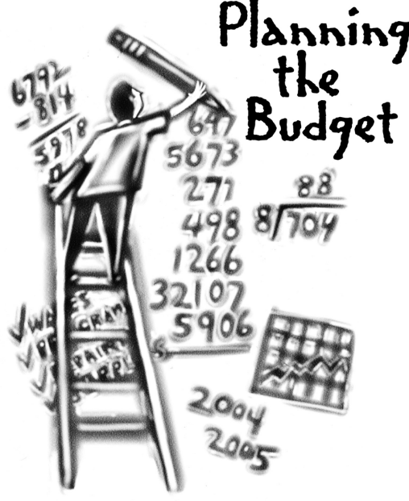
Overview of FY ‘24 GO Team Budget Process
Step 7 GO Team Final Budget Approval Meeting
Budgets Approved by March 17
Step 6 Principals: HR Staffing Conferences Begin
Late February – Early March
Step 5
GO Team Feedback Session: Draft Budget Presented & Discussed February – multiple meetings, if necessary
Step 4 Principals: Associate Supt. Discussions and Review
February (supports needed, specific challenges, coaching)
Step 3 GO Team Initial Budget Session: Allocation
January 24 – early February
Step 2 Principals: Workshop FY 24 Budget
January 24
Step 1 Review and Update Strategic Plan and Rank Strategic Priorities
By end of Fall Semester
GO Teams are encouraged to have ongoing conversations

Slide 5
Budget Feedback Meetings
What
The GO Team feedback session(s) should be scheduled for the principal to provide an overview of the school’s draft budget for the GO Team members and the general public.
Why
This meeting provides an opportunity for GO Teams to discuss how the school’s budget has been allocated to support the programmatic needs and key strategic priorities.
When
Meetings must be held in February before staffing conferences. May be combined with the allocation meeting (as needed), if the GO Team has completed strategic plan updates and ranked strategic priorities.
Notes:
Looking for general consensus prior to Staffing Conferences

Slide 6

FY24 Budget Parameters
FY24 School Priorities | Rationale
Improve student mastery of core content knowledge in literacy and mathematics. | More than 50% of our scholars are performing at the beginning level in literacy and mathematics. Less than 20% of our students are scoring at proficient and above.
Build teacher capacity in core content areas, literacy and mathematics. | We know that the most important work of the teacher is providing strong tier one instruction. In order to provide quality tier one instruction, we must be able to invest in our teachers. Ensuring they are receiving the knowledge and training that connects to the most current research-based strategies to support our students.
Utilize various interventions to support closing our current academic gaps. | Due to COVID-19, we have seen an impact on student achievement. Students have gaps within their learning that need to be addressed in order for students to be successful at their given grade level. Interventions are one tool that can be used to effectively close these gaps through an individualized approach.
Notes:
Review the priorities that the GO Team has developed and the rationale for these priorities. Feel free to copy this slide if you have more than 3 priorities to account for.

Slide 7
Descriptions of Strategic Plan
Breakout Categories
Priorities: FY24 funding priorities from the school’s strategic plan, ranked by the order of importance.
APS Five Focus Area: What part of the APS Five is the priority aligned to?
Strategies: Lays out specific objectives for schools improvement.
Request: “The Ask” What needs to be funded in order to support the strategy?
Amount: What is the cost associated with the Request?

Slide 8
FY24 Strategic Plan Break-out
Priorities | APS FIVE Focus Area | Strategies | Requests | Amount
Improve student mastery of core content knowledge in literacy and mathematics. | Curriculum & Instruction/ Data Driven Instruction | Implementation of new math curriculum (state & district adoption) | Purchase a K-5 Reading Teacher and K-5 Math Teacher | $181,838.00
Build teacher capacity in core content areas, literacy and mathematics. | Curriculum & Instruction | Provide professional learning for science of reading best practices for reading instruction to support all learners. Provide professional learning on new math standards and program. Provide full coaching cycle support to teachers to provide in-classroom support of instructional strategies. | Purchase a Literacy Instructional Coach and Mathematics Instructional Coach | $228,225.00
Utilize various interventions to support closing our current academic gaps. | Intervention & Whole Child | Provide targeted small group instruction, based on data, in both reading and mathematics. | Purchase a K-5 Reading Teacher and K-5 Math Teacher | $181, 838.00
Notes:
For the next few slides, I will show you how I have allocated the budget to support our strategic priorities.
Based on our strategic priorities and funds we received, here is a break-out of the priorities, which focus area it addresses, the strategies that will be implemented, the purchase request, which funding source was used and the amount.

Slide 9
Plan for FY24 CARES Allocation $(178,000)
Priorities | APS FIVE Focus Area | Strategies | Requests | Amount
Utilize various interventions to support closing our current academic gaps. | Whole Child Support | Provide social and emotional supports to both students and teachers to be able to effectively implement academic strategies of support. | Purchase a full time Counselor | $114, 013
Utilize various interventions to support closing our current academic gaps. | Curriculum & Instruction | Provide additional small group support to targeted grade levels/students throughout the day. Grade levels will be determined based on data. | Purchase a full time Paraprofessional | $46,696.00
Improve student mastery of core content knowledge in literacy and mathematics. | Curriculum & Instruction ; Personalized Learning | Provide a vast array of online programs, not provided by the district, that allow for individualized instruction | Web Based Subscription Renewal | $8,319
mprove student mastery of core content knowledge in literacy and mathematics. | Signature Programming | This is a requirement to maintain our IB status. | Purchase IB Dues | $9,000
Notes:
For the next few slides, I will show you how I have allocated the budget to support our strategic priorities.
Based on our strategic priorities and funds we received, here is a break-out of the priorities, which focus area it addresses, the strategies that will be implemented, the purchase request, which funding source was used and the amount.

Slide 10
Plan for FY24 Title I Family Engagement Funds
$___6000___
Priorities | APS FIVE Focus Area | Strategies | Requests | Amount
Improve student mastery of core content knowledge in literacy and mathematics. | Curriculum and Instruction, Data Driven Instruction | Academic Parent Teacher Teams (K-5) | Academic Events (3 times during the year minimum and parent teacher conferences each semester) | $6,000
Notes:
For the next few slides, I will show you how I have allocated the budget to support our strategic priorities.
Based on our strategic priorities and funds we received, here is a break-out of the priorities, which focus area it addresses, the strategies that will be implemented, the purchase request, which funding source was used and the amount.

Slide 11
Budget by Function (Required)
*Based on Current Allocation of School Budget
School | Barack & Michelle Obama Academy
Location | 5066
Level | ES
Principal | Robin Christian
Projected Enrollment | 231
Account | Account Description | FTE | Budget | Per Pupil
1000 | Instruction | 29.50 | $2,612,379 | $11,309
2100 | Pupil Services | 4.33 | $473,875 | $2,051
2210 | Improvement of Instructional Services | 3.00 | $334,932 | $1,450
2213 | Instructional Staff Training | - | $- | $-
2220 | Educational Media Services | 1.00 | $106,750 | $462
2400 | School Administration | 5.00 | $546,887 | $2,367
2600 | Maintenance & Operations | 3.00 | $169,348 | $733
2700 | Transportation | - | $- | $-
Total |  | 45.83 | $4,244,172 | $18,373
Notes:
I am passing out the definitions for these funding categories. You will see what makes up each category. Although the school’s total budget amount will not change, allocation per function may change depending on our conversations and school needs.

Slide 12
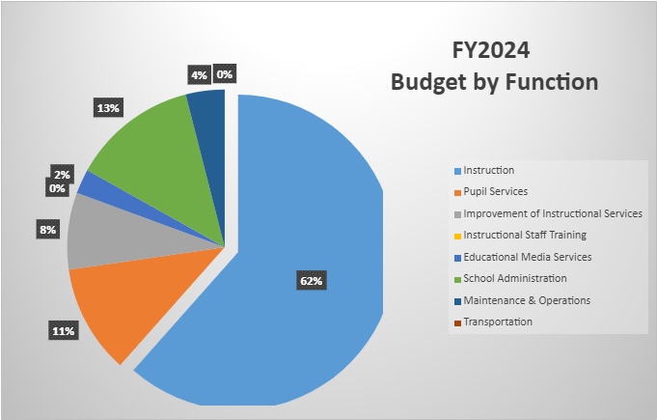
Budget by Function (Required)
*Based on Current Allocation of School Budget
Notes:
Explain the pie chart and allocations

Slide 13
DISCUSSION OF RESERVE AND HOLDBACK FUNDS

Slide 14
Plan for FY24 Leveling Reserve
$51,318
Priorities | APS FIVE Focus Area | Strategies | Requests | Amount
Utilize various interventions to support closing our current academic gaps. | Personalized Learning/ Curriculum & Instruction | Provide targeted small group instruction, based on data, in both math and reading. | Purchase Hourly Reading and Mathematics Teacher Tutor | $38,844.00
Utilize various interventions to support closing our current academic gaps. Build teacher capacity in core content areas, literacy and mathematics. | Curriculum & Instruction, Whole Child | Provide teachers with additional compensation for professional learning and support of school programs beyond the work day. | Provide Teacher Stipends for Ongoing Professional Development | $12,474.00
Notes:
For the next few slides, I will show you how I have allocated the budget to support our strategic priorities.
Based on our strategic priorities and funds we received, here is a break-out of the priorities, which focus area it addresses, the strategies that will be implemented, the purchase request, which funding source was used and the amount.

Slide 15
Plan for FY24 Title I Holdback $17, 208
Priorities | APS FIVE Focus Area | Strategies | Requests | Amount
Build teacher capacity in core content areas, literacy and mathematics. | Curriculum & Instruction | Provide teacher PL around reading strategies and techniques to grow teacher practices on improving instruction. Provide teacher PL on new math standards and the adoption of new curriculum. | Purchase Professional Development | $17, 208
Notes:
For the next few slides, I will show you how I have allocated the budget to support our strategic priorities.
Based on our strategic priorities and funds we received, here is a break-out of the priorities, which focus area it addresses, the strategies that will be implemented, the purchase request, which funding source was used and the amount.

Slide 16
QUESTIONS FOR THE GO TEAM TO CONSIDER AND DISCUSS
Are our school’s priorities (from your strategic plan) reflected in this budget?
  Are new positions and/or resources included in the budget to address our major priorities?
  Do we know (as a team) the plan to support implementation of these priorities beyond the budget (ex. What strategies will be implemented)?
  What tradeoffs are being made in order to support these priorities?
How are district and cluster priorities reflected in our budget?
  Cluster priorities- what staff, materials, etc. are dedicated to supporting our cluster’s priorities?
  Signature programs- what staff, materials, etc. are dedicated to supporting our signature program?
  Are there positions our school will share with another school, i.e. nurse, counselor?
Notes:
CHAIR - Our final task for today! Here are questions that we need to consider to ensure we have a good working draft budget. Let’s walk through them together.

Slide 17
Where We’re Going?
Our next meeting is the Budget Approval Meeting
What:
During this meeting we will review the budget, which should be updated based on feedback from the staffing conference, Associate Superintendents, and key leaders. After review, GO Teams will need to take action (i.e., vote) on the FY24 Budget.
Why:
Principals will present the final budget recommendations for GO Team approval.
When:
All approval meetings must be held after staffing conferences. Budgets must be approved by March 17th.

Slide 18
What’s Next?
February
  HR Staffing Conferences (Late February)
March
  Final GO Team Approval Meeting (AFTER your school’s Staffing Conference and BEFORE Friday, March 17th)
Notes:
In February, we will meet again to discuss how the school’s budget has been allocated to support the programmatic needs and FY23 key strategic priorities.
If think we need to continue our budget conversations, we will schedule additional meetings. My goal is to make sure your voices are reflected in our school’s budget.
I will also be meeting with my Associate Superintendent, program managers and other key leaders to go over our budget and to make sure the school is meeting the standards of service and appropriately staffing.
During the week of Feb. 24th -March 2nd , HR Staffing Conferences will be held. At this meeting, I will present my plan for staff utilization, resource distribution and plan for staffing implications.
We will need to approve the budget at the ________ meeting.

